Slide 1
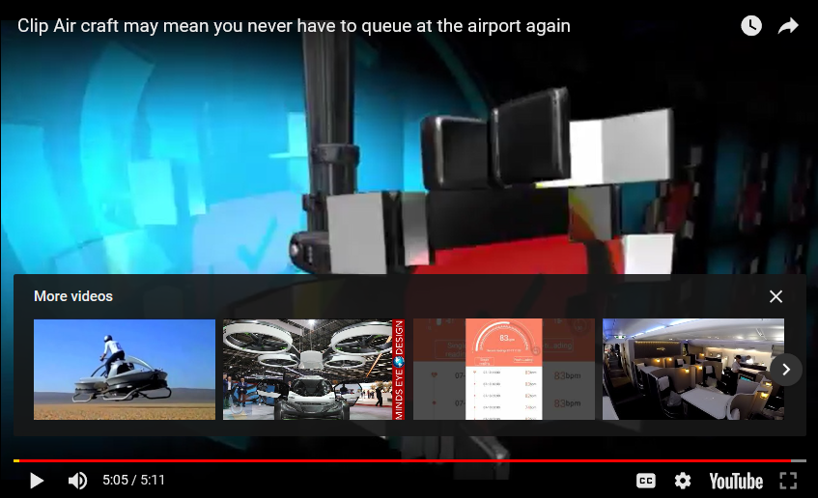
Clip-Air
Notes:
Business Model: Value proposition, Supply chain, Target customer
Tech: Product/ service, Process tech, Enabling tech
5:11
https://www.youtube.com/watch?v=k1H1B5lZAqM
https://www.cnn.com/travel/article/clip-air-pod-airplane-concept/index.html

Slide 2

Ehang 184 Taxi Drone
Notes:
Business Model: Value proposition, Supply chain, Target customer
Tech: Product/ service, Process tech, Enabling tech
3:24
https://www.youtube.com/watch?time_continue=4&v=i3i4BBJjzw4

Slide 3

Vignette: Where good ideas come from
Notes:
4:07
One of our most innovative, popular thinkers, Steven Johnson takes on (in exhilarating style) one of our key questions: Where do good ideas come from?
http://www.youtube.com/watch?v=NugRZGDbPFU

Slide 4
Conclusion: Applying the Innovation Rules to Your Organization
Chapter 10
Notes:
Business Model: Value proposition, Supply chain, Target customer
Tech: Product/ service, Process tech, Enabling tech

Slide 5
M.I.W. Chapter 10: Applying the Innovation Rules
Combining Creativity with Commercial Savvy
“The key to the whole game is to innovate and to make a profit.”
– Kevin Rollins, CEO, Dell

Slide 6
Smart Execution – Return to the 7 Rules
Exert Strong Leadership defining the innovation strategy and designing innovation portfolios and encourage truly significant value creation.
Match innovation to the company business strategy including selection of the innovation strategy (Play-to-win or play-to-lose)
Make innovation an integral part of the company’s business mentality, and ensure that the processes and organization support an innovation culture.
Balance creativity and value capture so that the company generates successful new ideas and gets the max. R.O.I.

Slide 7
7 Innovation Rules, cont.
Neutralize organizational antibodies that kill off good ideas because they are different from the norm. Inertia of status quo
Create innovation networks that includes people and knowledge both inside and outside the organization.
Implement the right metrics and rewards for innovation. We are all slaves to our reward system
These rules are interdependent

Slide 8
The Role of Leadership
Leadership must define the innovation strategy and link it to the business strategy
Innovation must be aligned with the company business strategy, including selection of the innovation strategy
Leadership must define who will benefit from improved innovations.
  Who are the targets for value creation from innovation? Profit, the consumer, suppliers, distributors, employees?

Slide 9
Diagnostics and Action
Salesforce.com requires that all new initiatives and products be reviewed using V2MOM:
  Vision: What do you want?
  Values: What’s important about it?
  Methods: How do you get it?
  Obstacles: What is preventing you from getting it?
  Measures: How will you know when you got it?
– refer to table 10.1 on page 272 for more diagnostics

Slide 10
Generating Innovation Value
There is no silver bullet for innovation, no one formula or structure for innovation that will work for every organization. The seven Innovation Rules provide the basis for executing improved innovation that creates value and growth.

Slide 11
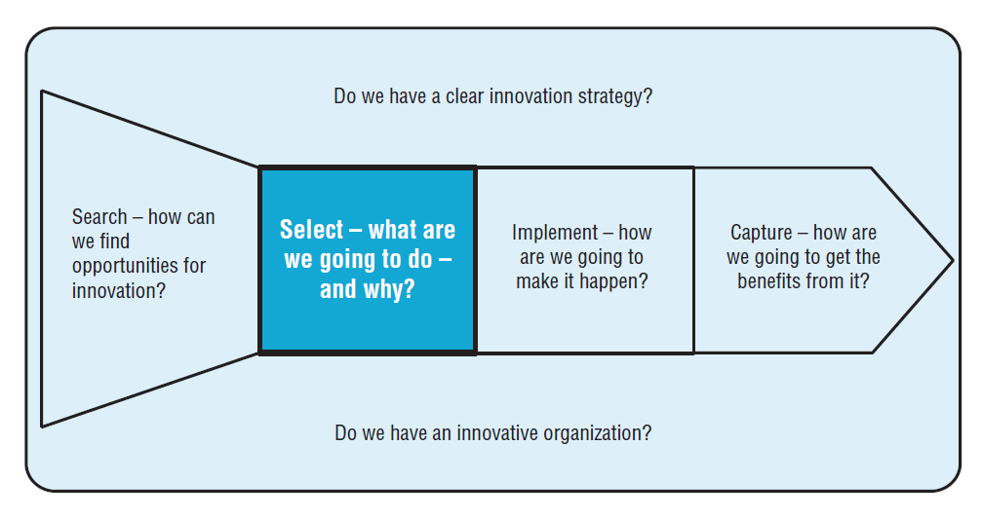
The Innovation Process
Innovation Rule 1. Exert Strong Leadership defining the innovation strategy and designing innovation portfolios and encourage truly significant value creation.
Notes:
Innovation Rule 1. Exert Strong Leadership defining the innovation strategy and designing innovation portfolios and encourage truly significant value creation.
(Similar to MIW Fig 5.2, p. 125: Generation of ideas → selection → executions → Creation of value)

Slide 12
How organizations learn…
Experience
Experiment
Learning
Reflect
Concept
Notes:
Part of the strategy involves learning
CH 5: Designing the process of innovation

Slide 13
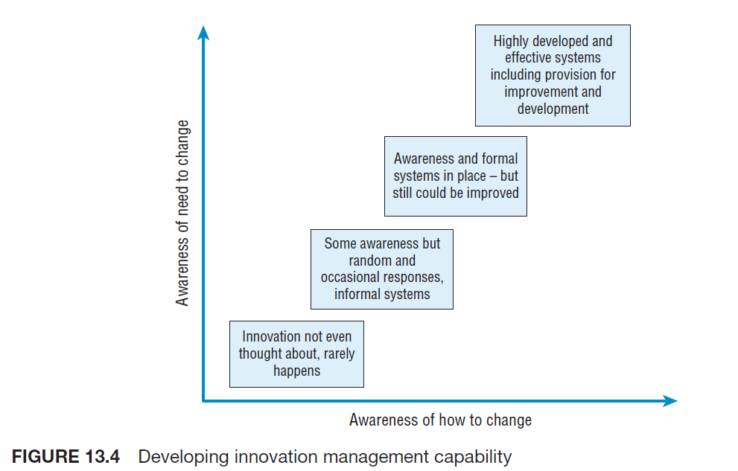
Learning to manage innovation
Innovation Rule 3. Make innovation an integral part of the company’s business mentality
Notes:
Innovation Rule 3. Make innovation an integral part of the company’s business mentality, and ensure that the processes and organization support an innovation culture.

Slide 14
It’s a great idea but ......
Innovation Rule 5. Neutralize organizational antibodies
It’s not our business
It’s not a business
It’s not big enough
Not invented here
Invented here
We’re not cannibals
Nice idea but doesn’t fit
It’s not broken….
Great minds think alike
(existing) customers don’t want it
We’ve never done it before
We’re doing OK
Let’s set up a pilot
Notes:
Innovation Rule 5. Neutralize organizational antibodies that kill off good ideas because they are different from the norm.
Don’t want to be saying as a manager…List of excuses, lack of commitment
14

Slide 15
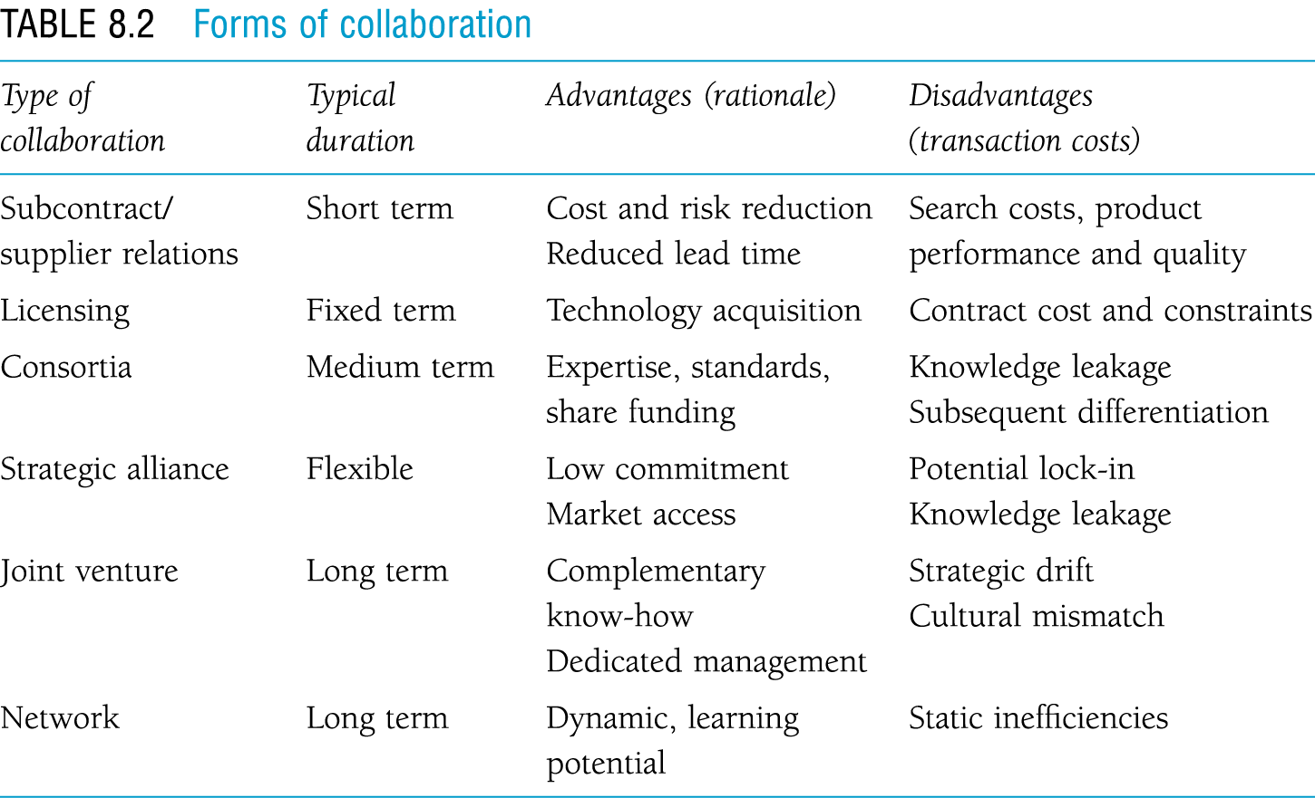
Table 8.2 Forms of collaboration
Innovation Rule 6. Create innovation networks
15
Notes:
Innovation Rule 6. Create innovation networks that includes people and knowledge both inside and outside the organization.

Slide 16
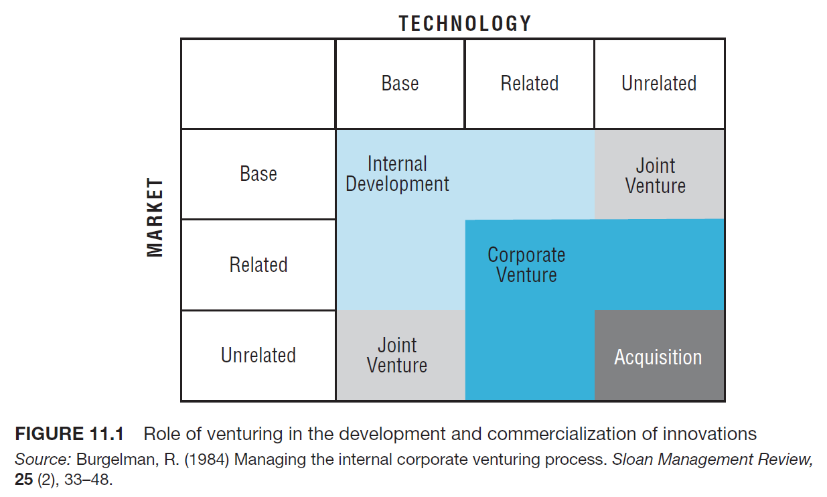
16

Slide 17
Managing Alliances
Only around half of all alliances are successful:
Strong partners - 67% succeed (vs. 40%)
Equal ownership - 60% succeed (vs. 31%)
Minimal overlap - 62% succeed (vs. 25%)
Flexible - 79% (vs. 33%)

Slide 18
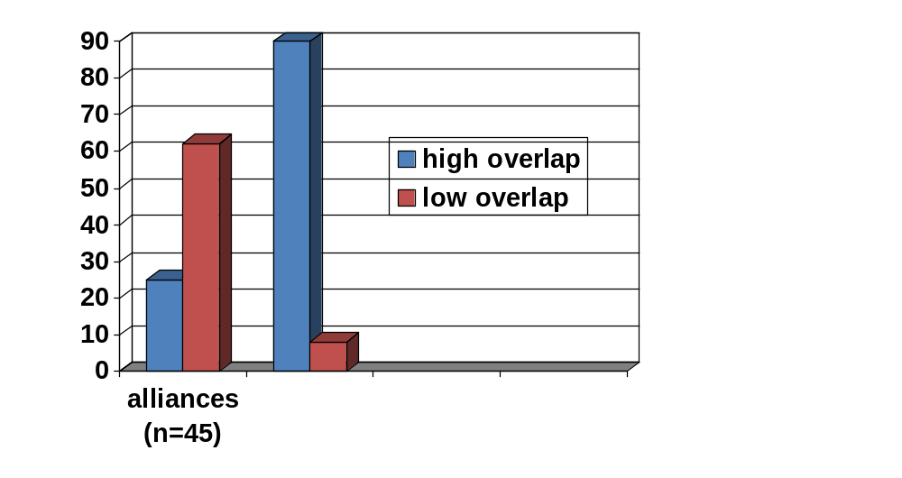
Alliances vs. Acquisitions
% success
acquisitions

Slide 19
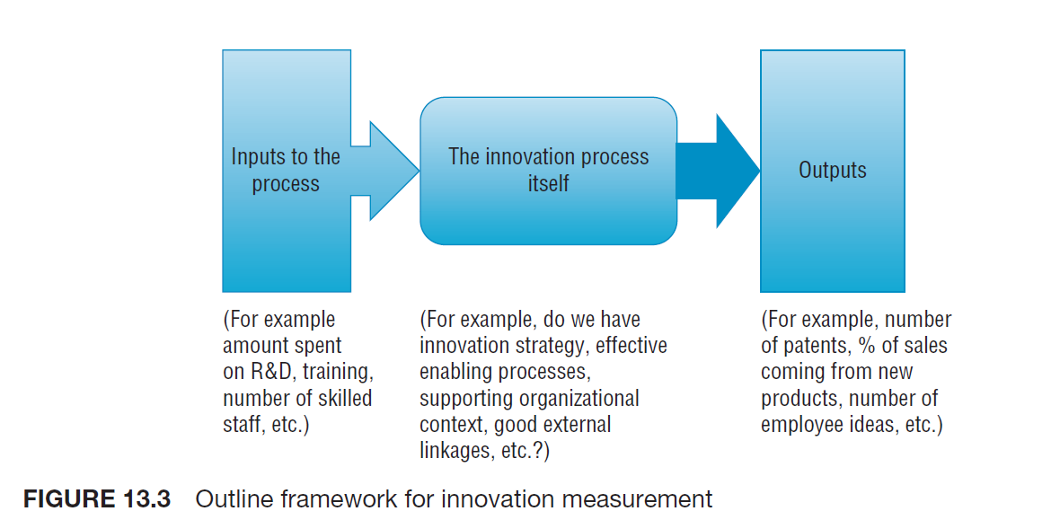
Monitoring and measuring innovation
Innovation Rule 7. Implement the right metrics and rewards for innovation
Notes:
Innovation Rule 7. Implement the right metrics and rewards for innovation.

Slide 20
Are we in shape for innovation?
Do we have effective enabling mechanisms?
Do we have an innovation strategy – and commitment to it?
Do we have an innovative organisation?
Do we have pro-active linkages?
Do we learn and build capability?

Slide 21
Innovation audit
Systematic exploration of core themes known to influence innovation success and failure
Interviews and questionnaire = self-assessment
Reference examples and performance data
Expert assessment
Regular monitoring as an aid to building innovation capability

Slide 22
Myth #10: Innovation is always good
“There is nothing either good or bad,
but thinking makes it so”
William Shakespeare
All innovations combine good and bad effects regardless of the intention of the Innovator or how well designed they are
– Berkun, S. (2007). The Myths of Innovation.

Slide 23
Myth #10: Innovation is always good
An innovation can be:
  Good for you
  Good for others
  Good for an industry or economy
  Good for a society
  Good for the world

Slide 24
Myth #10: Innovation is always good
We can ask the twin questions:
  What problems does this innovation solve?
    Whose problems are they?
  What problems does this innovation create?
    Whose problems are they?

Slide 25
The good and bad, the future and the past
As social creatures, we depend on traditions to form communities, governments, and families, and we believe these traditions are important enough to justify sacrificing our lives, or the lives of others, to protect them from change.
The grand irony is that all traditions, even religious ones, began as innovations.
Notes:
Everything was once new

Slide 26
The good and bad, the future and the past
The best philosophy of innovation is to accept both change and tradition and to avoid the traps of absolutes.
Never say never.
Ideas new and old have their place in the future.

Slide 27

Vertical Farming
Notes:
3:37
https://www.youtube.com/watch?v=-_tvJtUHnmU

Slide 28

TED: Simon Sinek – The Golden Circle
Notes:
5:55
http://www.youtube.com/watch?v=l5Tw0PGcyN0

Slide 29
Closing Vignette
Kawasaki speaks of his experiences as an evangelist, entrepreneur, and most recently, as a venture capitalist who found, fixed, and funded start-ups. http://www.youtube.com/watch?v=Y8X57eucxnI

